Slide 1
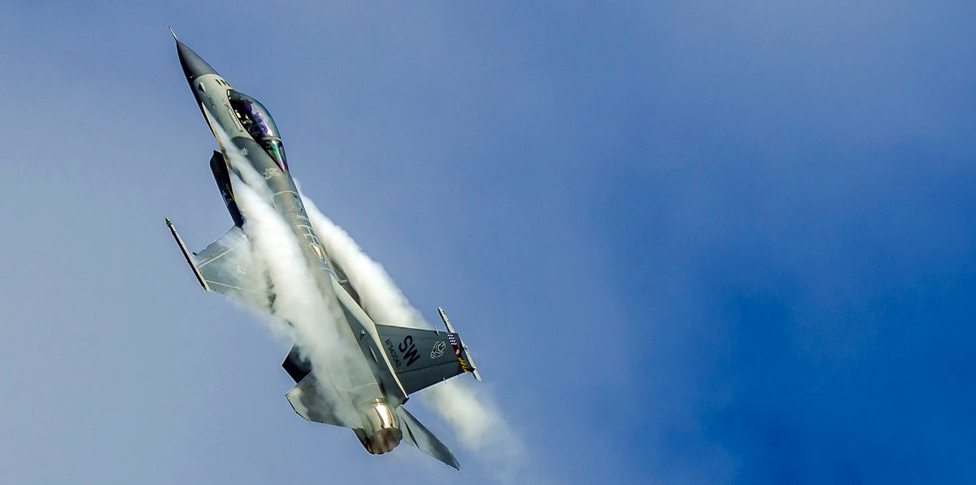
Introduction to BFM
Part One

Slide 2
What is BFM?
Maneuvering to gain a positional advantage over the enemy using:
Energy management
Geometry
Pursuit Curves
Applicable at short ranges (guns, fox 2)
In its simplest form, relevant to 1v1 engagements
Basis behind well known and effective maneuvers such has:
Yo-yo
Scissors
Lag displacement roll
Split-S
etc...

Slide 3
Learning BFM
One often learns BFM by studying maneuvers and trying and implement them when necessary, but BFM is highly dynamic.
This series of trainings aims to teach BFM through the basic fundamentals that the maneuvers are built upon, and hopefully result in a good, intuitive understanding.

Slide 4
The fundamentals
Energy
The management of an aircraft's kinetic and potential energy, it's conservation and recuperation.
Circle Flow
The turn rate of the aircraft, it's turn radius, and exploitation of either in one and two circle flow fights to gain an advantage.
Pursuit Curves
Choosing or forcing a lag, pure or lead pursuit.
Lift Vector Control
Understanding and managing the lift vector of one's aircraft in out of plane maneuvering.

Slide 5
Energy
Kinetic Energy
Related to how fast your aircraft is going. The faster your are, the higher your kinetic energy
Potential Energy
Related to your altitude. The amount of “stored” energy that can be converted into kinetic energy, such as in a dive.
Total energy is PE + KE. Therefore, a combination of altitude and speed.
Having a higher energy state than your opponent puts you at a significant advantage

Slide 6
The “energy banking” model
Potential
Kinetic
You have a steady income of energy: Engine Thrust.
Energy in potential form isn’t immediately useful.
It needs to be converted into kinetic to use against your opponent.
Since kinetic energy is related to speed, and the higher your speed, the higher your drag, this energy is highly taxed!
Transfer Kinetic back to Potential when it’s not being used
Always be saving! Top up that tax free potential energy account whenever possible
Tax Free Swiss Bank Account (Savings)
Spending Account
No tax. The amount you store in this account doesn’t depreciate.
Not immediately accessible. You can’t do anything useful with your savings until you withdraw them.
Immediately spendable.
High tax rate (in the form of drag!). Funds in this account slowly deplete even if you’re not spending them on anything useful.

Slide 7
Energy Management in practice
Aim to have a higher energy state than your opponent before engaging
Climb to high altitude
Maintain reasonably high speed
Spend energy wisely
High AoA maneuvers bleed energy fast
During a dogfight you’ll likely be spending more energy than you’re earning but so is your opponent, so try to budget better than them.
Recuperate PE when possible
E.g: You go for guns on an enemy at high speed, sending them defensive, allowing you to disengage on the egress, climb and recuperate PE before turning in for another attack

Slide 8
Circle Flow
Circle flow emerges from two basic principles:
Turn rate
How quickly your aircraft turns (degrees per second). An aircraft that can turn a full 360 degrees faster than another has a higher turn rate. Higher rate is better.
Turn radius
How large the radius of the turning circle is. Smaller radius is better.
For each aircraft there is an optimal speed for both rate and radius
Having a high turn rate does not mean also having a small turn radius and vice versa. These asymmetries between different aircraft and their speeds can be exploited to gain an advantage.

Slide 9
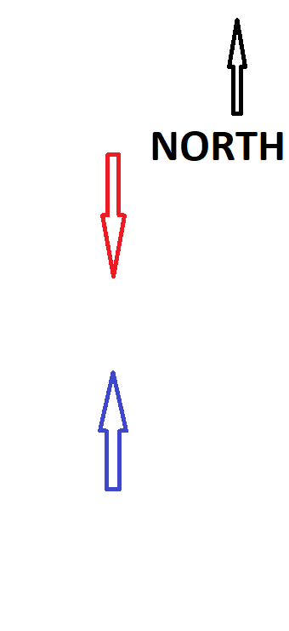
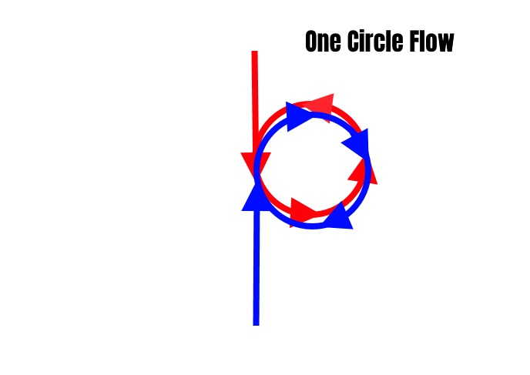
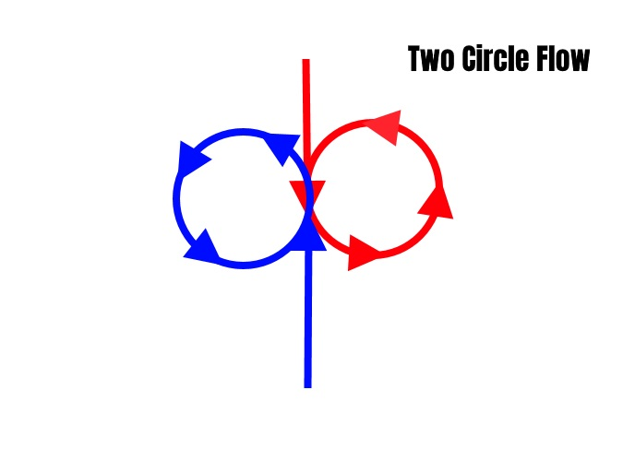
Circles
Both aircraft turn in the same cardinal direction (e.g, east)
They follow the same circle in the same direction
Favours smaller turn radius
Aircraft turn in opposite cardinal directions (e.g, one to the east and one to the west)
They turn in different circles meeting in a second head-on merge.
Favours faster turn rate

Slide 10
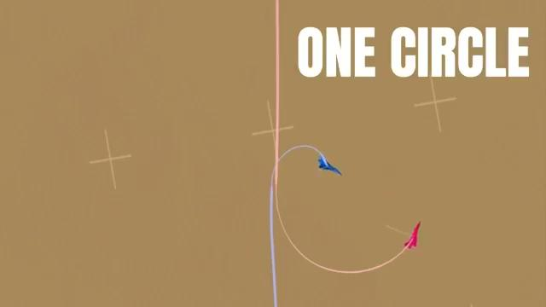
One Circle

Slide 11
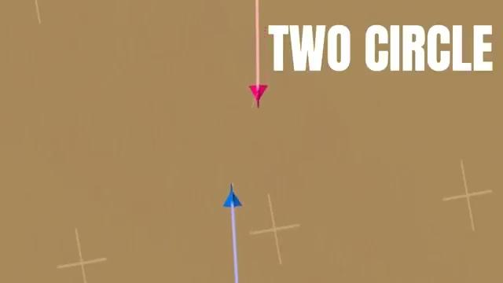
Two Circle

Slide 12
Pursuit Curves
A pursuit curve determines whether you are either closing, maintaining or enlarging the distance between yourself and the opponent while in a turn.
Lead pursuit
You are aiming in-front of the opponent’s nose (i.e. leading)
Use it to close distance and/or get a guns lead firing solution
Pure pursuit
You are following the same turn as the opponent. You flight path is pointing directly at them.
Use to chase the opponent at the current distance
Lag pursuit
Your flight path is lagging behind the enemy
Use to avoid overshooting, create distance to get a good missile solution etc

Slide 13
Pursuit Curves

Slide 14
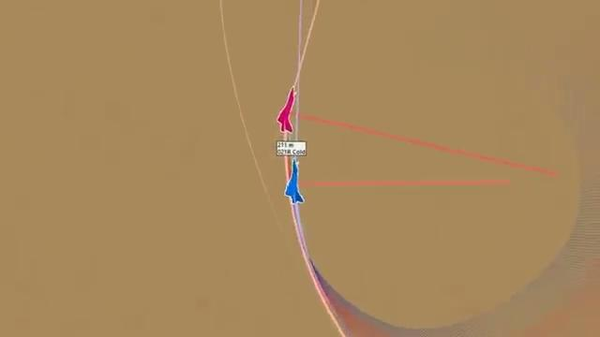
A closer look at lead

Slide 15
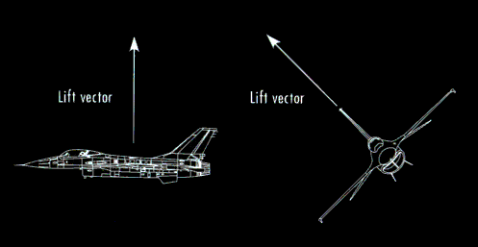
Lift Vector
Points in the direction of your aircraft’s lift.
In the cockpit, look directly above you. That is roughly where your lift vector is pointing.
Useful to utilise the lift vector in out of plane maneuvering (circles that are not limited to horizontal turns)
In out of plane maneuvering, your lift vector is used like your flight path vector for pursuit curves.

Slide 16
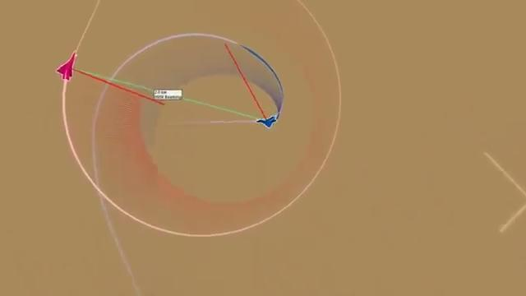
Lift Vector circles

Slide 17
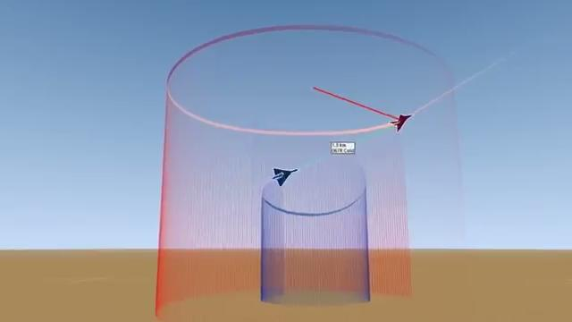
Low yo-yo

Slide 18
Bringing it all together...
The simple yo-yo maneuver brings together all fundamentals of BFM:
Energy:
The low yo-yo involves a dive that trades altitude for speed: PE for KE
Circles:
It effectively tightens turn radius in a one circle fight
Pursuit curves
Lead pursuit is exploited to achieve an offensive position starting from a neutral one
Lift Vector
The lift vector is exploited in OOP maneuvering to achieve the lead pursuit

Slide 19
Exercises
Split into small groups (3-4)
Each group will rotate between spectator and participant in head-to-head air spawns to practice BFM.
Groups will be of mixed ability to allow the less experienced to receive feedback and demonstrations.
Rules:
No shooting before the merge
Unless stated as part of the exercise, no large amount of tactical maneuvering before the merge
If nothing more can be learned from a fight, call “knock it off” to immediately cease the fight and be ready to spawn again (Avoid fighting until you’re both gliding on empty tanks)
Try to keep the airframes the same at the beginning, e.g F-16 vs F-16 or F-14 vs F-14
Move onto the next exercise only when everyone (spectators and participants) have completed the current one.
Not a competition - be cooperative with your “enemy” and learn together

Slide 20
Exercise 1: Warm up
Practice two fights each with neutral merges, to get a feel of things and and warm up
Do not worry too much about tactics, which circles to force/choose etc at this stage.
Use these fights to note how the aircraft behaves at different speeds and g-loads.

Slide 21
Exercise 2: Energy Asymmetry
Deliberately create an energy asymmetry before the merge, from altitude, speed, or both.
Note what effects this asymmetry has on the fight and how often each aircraft is able to assume offensive positions.
Take it in turns so everyone has a go at being the high energy and low energy aircraft

Slide 22
Exercise 3: Circles and freeform
Choose and agree on what circle geometry will be used on the merge. Try both a one and two circle fight - note how this affects situational awareness of your enemy after the merge.
Continue the rotating fights in a free-form fashion, exploring and exploiting the concepts from the slides (circles, pursuit curves, life vector, out of plane manoeuvring etc..)

